Slide 1








PADYAK KALIKASAN
AN AVENUE TOWARDS GREENER AND HEALTHIER CITIES
TEAM DEBONAIROS
Jens Liam Vista & Karl Josef Malaki
TECHNOLOGICAL INSTITUTE OF THE PHILIPPINES - QUEZON CITY

Slide 2


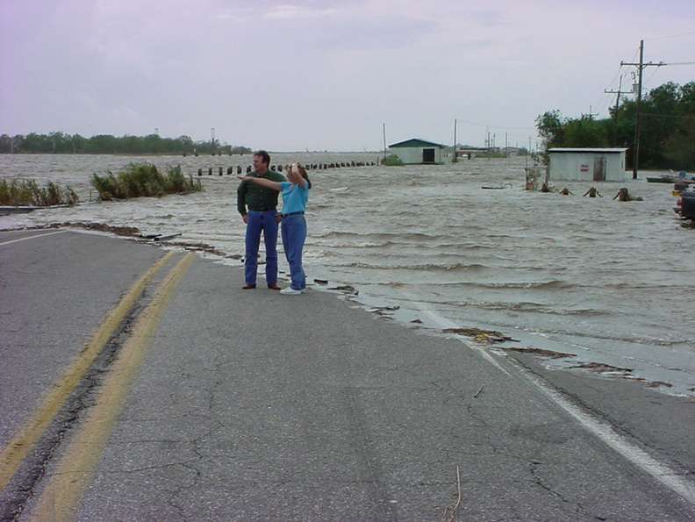
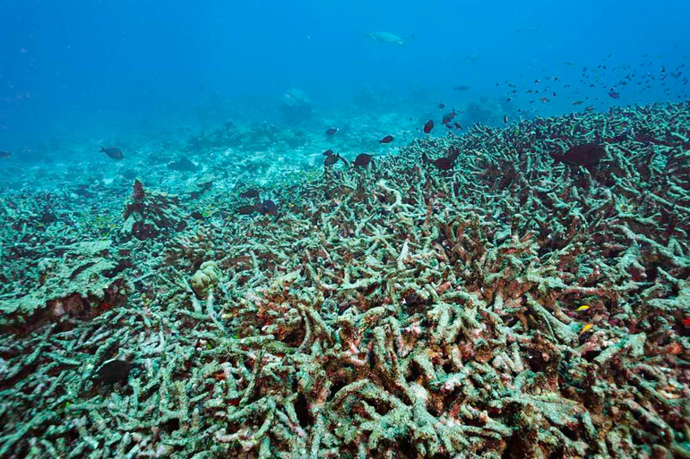
PHOTOGRAPH BY BJORN ANDERS NYMOEN, MYSHOT
PHOTOGRAPH COURTESY OF NOAA
PHOTOGRAPH BY MARK SHAEFFER, MYSHOT

Slide 3
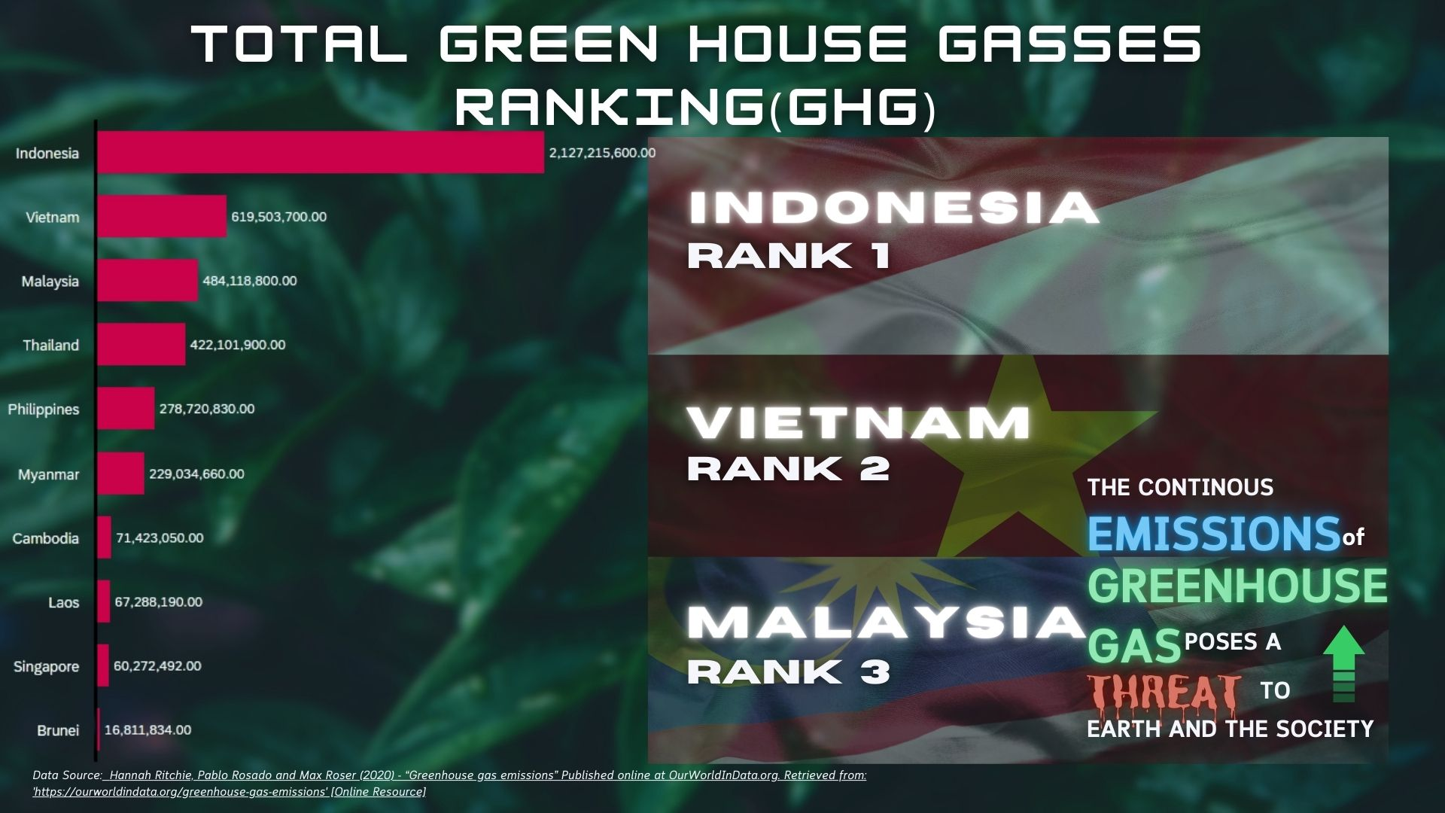

Slide 4
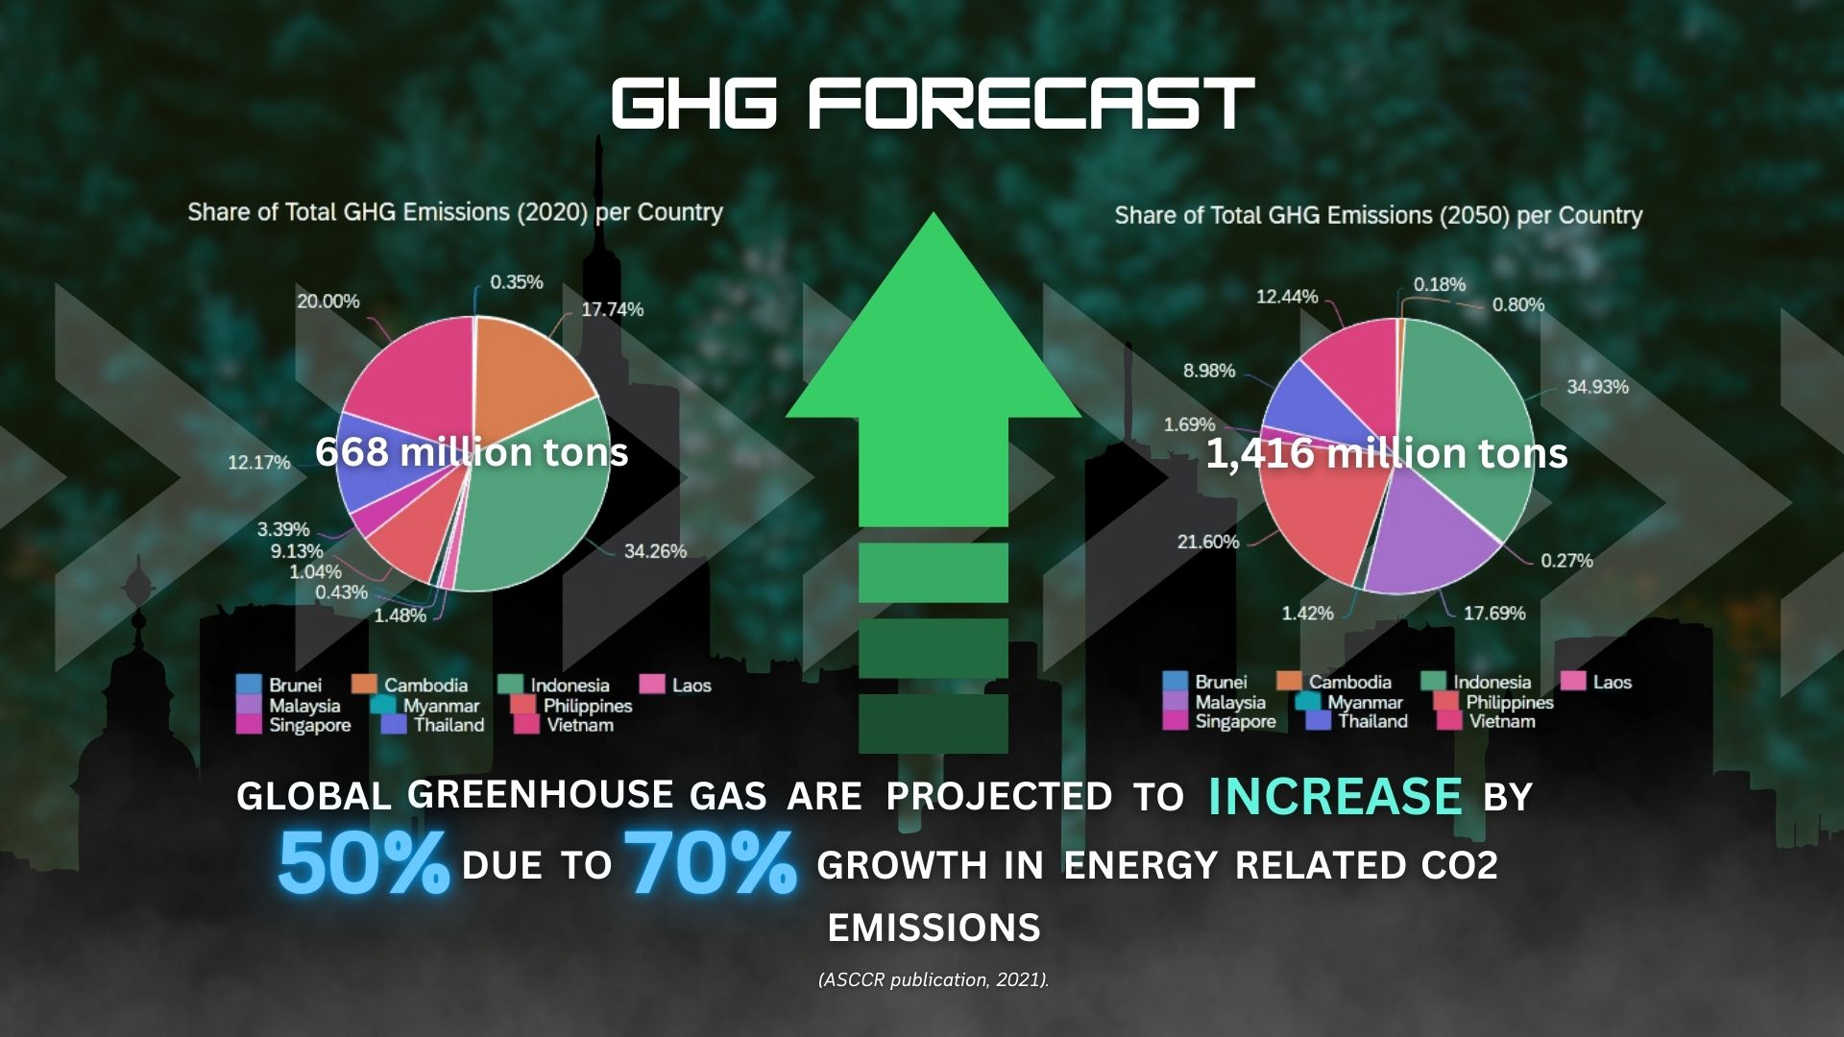

ghg forecast

Slide 5
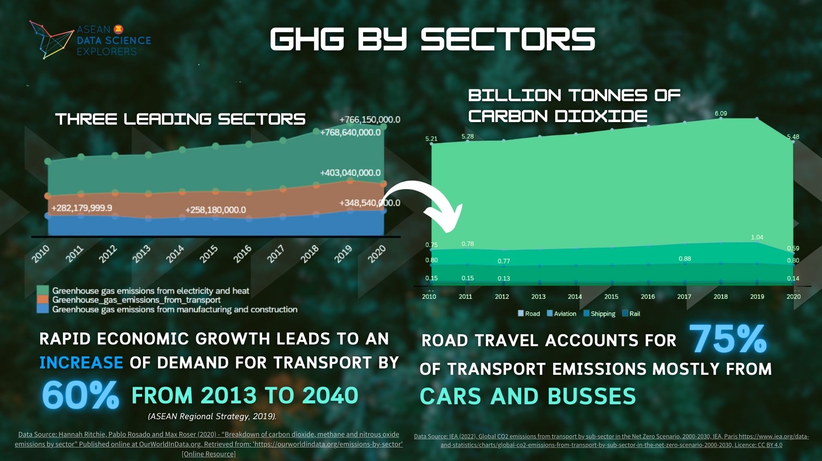

Slide 6
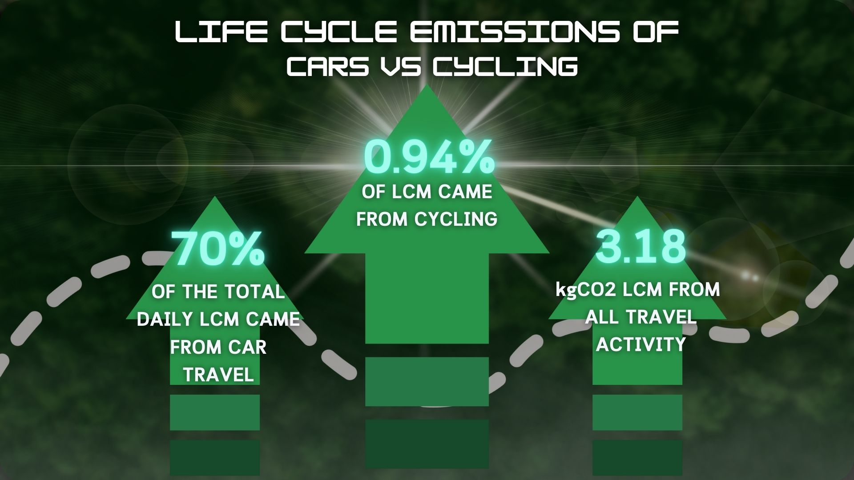

Slide 7
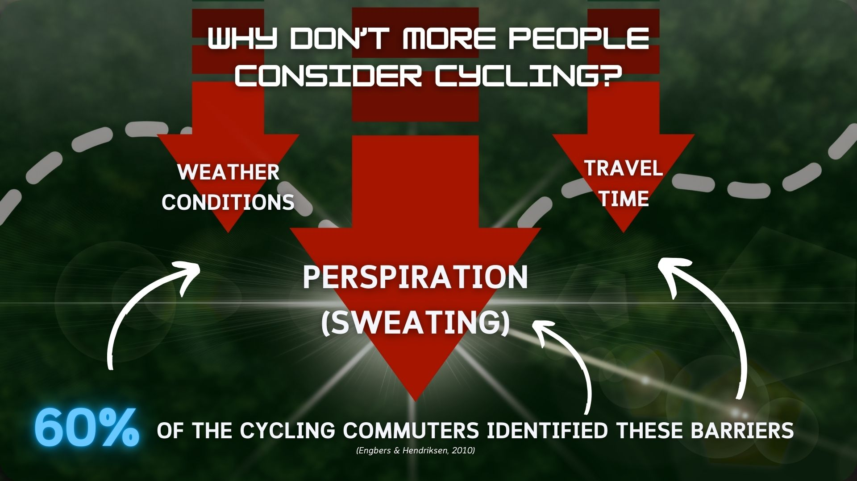

Slide 8
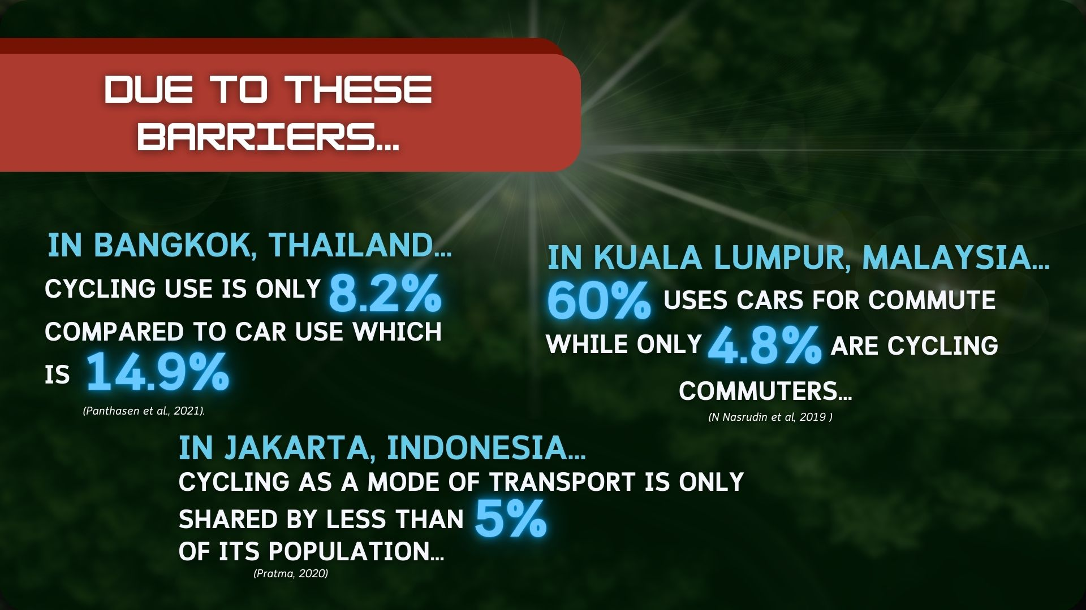

Slide 9


“TWO-WHEELERS PLAY A KEY ROLE FOR ACCESSIBILITY IN DENSE CITIES; ELECTRIFICATION IS KEY TO MAKE IT A SUSTAINABLE MODE.”
(ASEAN Regional Strategy, 2019).

Slide 10
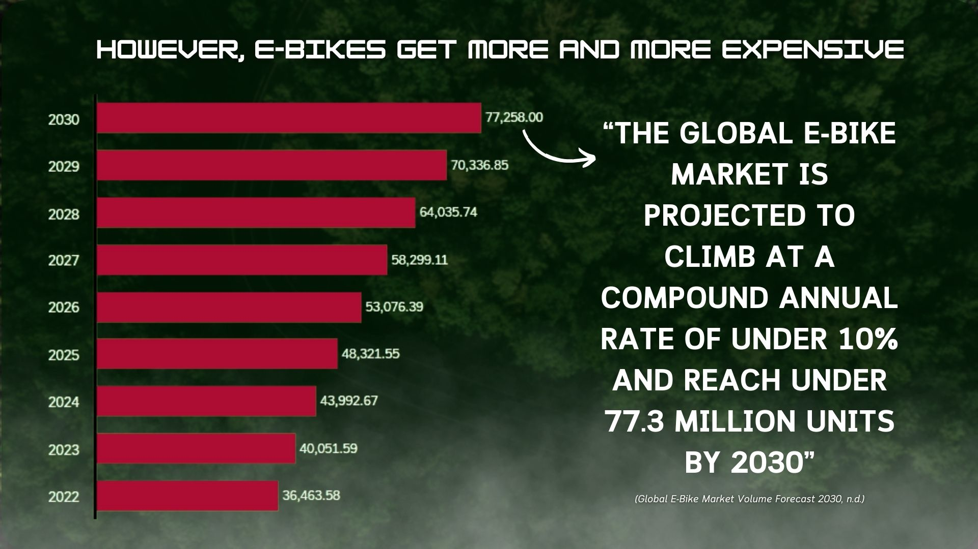

Slide 11
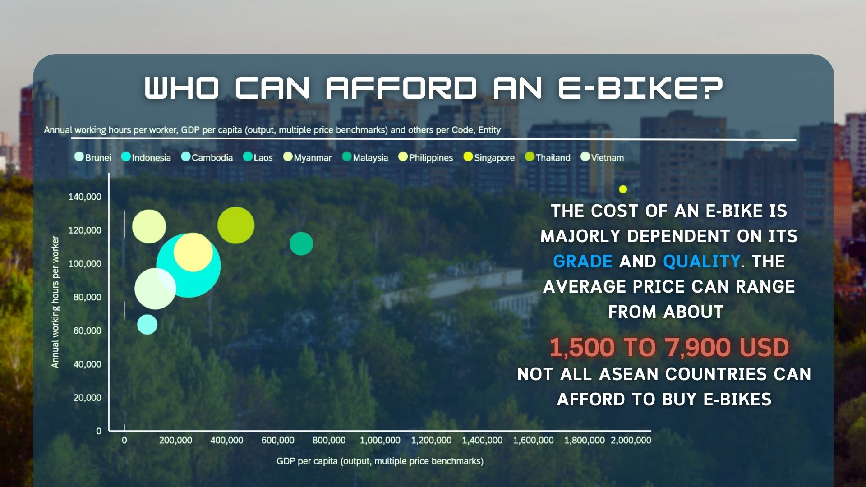

Slide 12

CHOOSING AN ALTERNATIVE IS MORE EFFECTIVE IF IT REUSES EXISTING RESOURCES AND ENHANCES AFFORABILITY

Slide 13
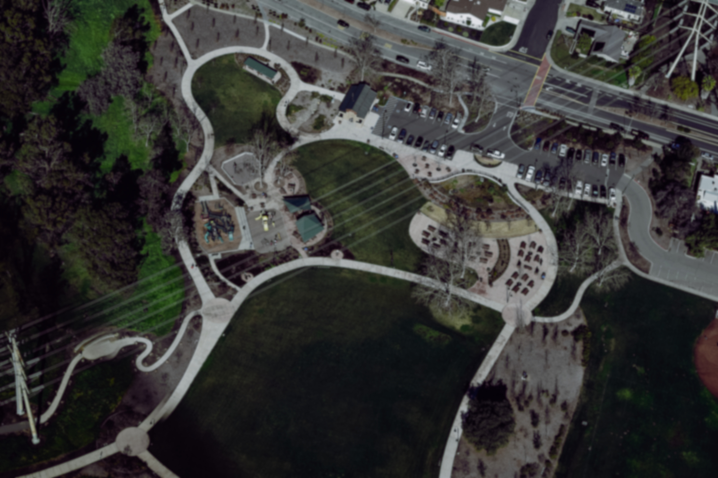


INTRODUCING A COST-EFFECTIVE ALTERNATIVE
Advanced control system powered by Arduino
Zeca Ride
Offers extended operation through sustainable power acquisition
Zeca Ride is made possible due to the rapid advancement of IoT technology. It is a portable electric bike conversion kit that transforms a regular bicycle into an electric bike.
Ensures both efficiency and safety
Powerful motors capable of achieving high speeds

Slide 14
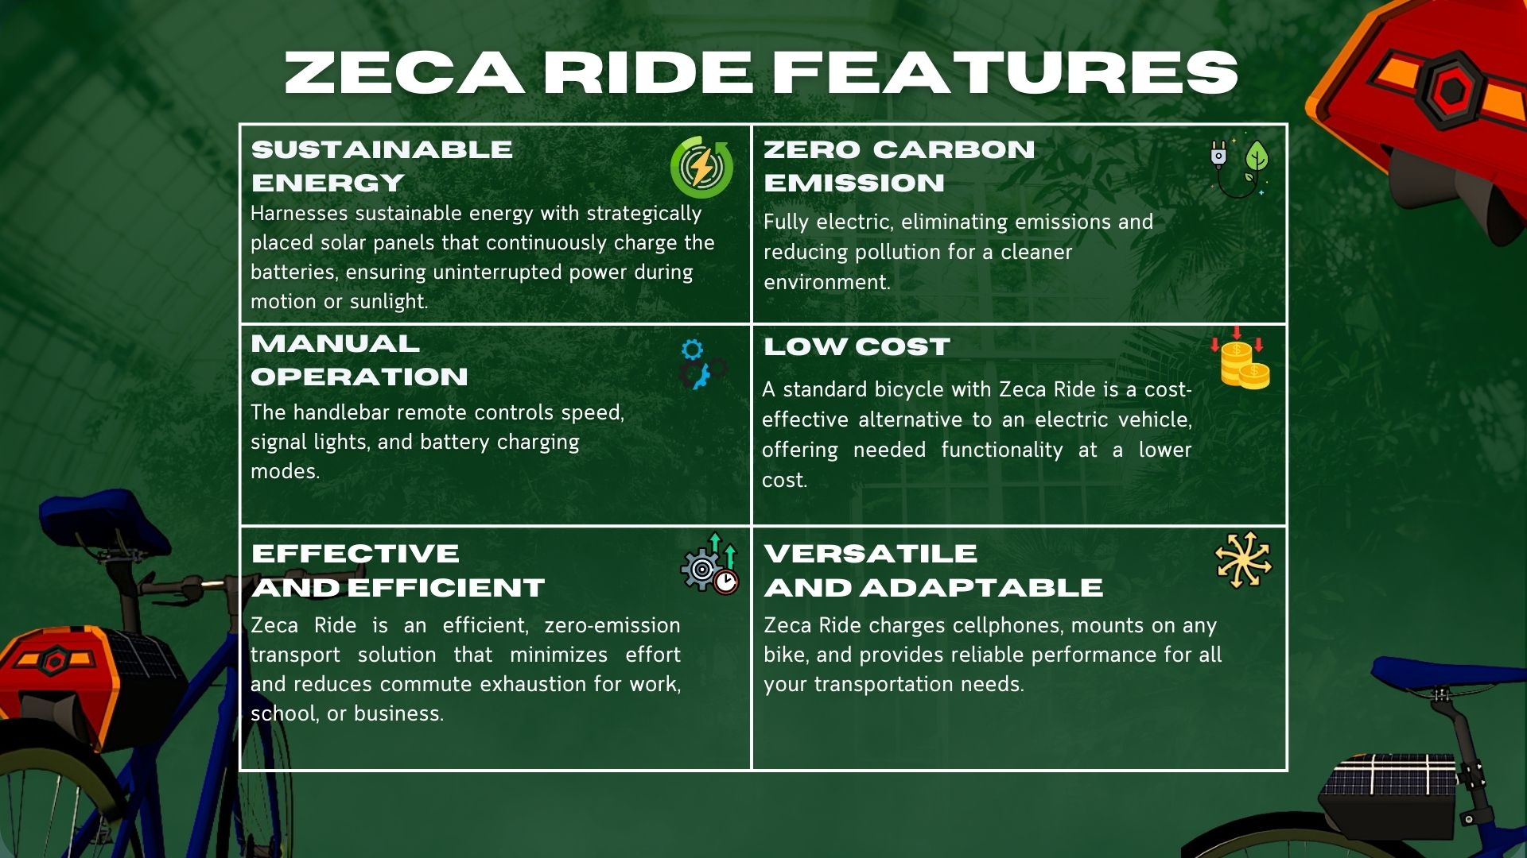

Slide 15
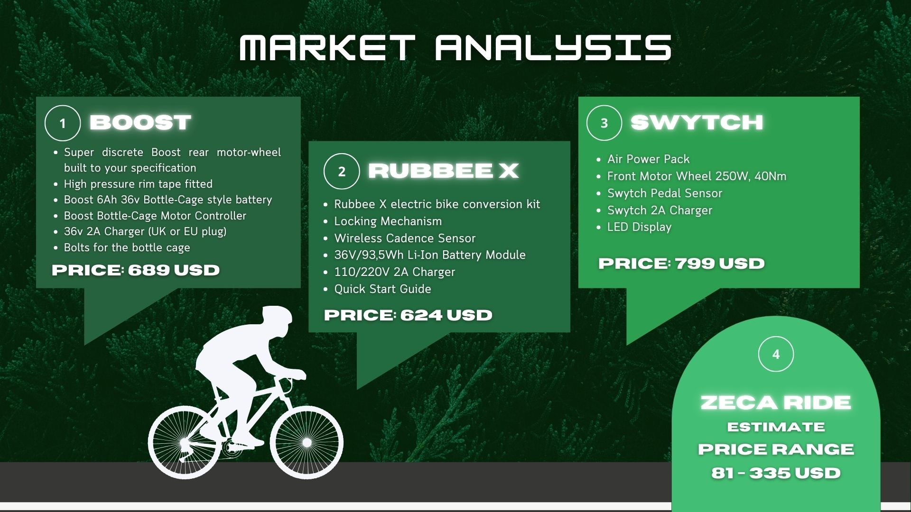

Slide 16
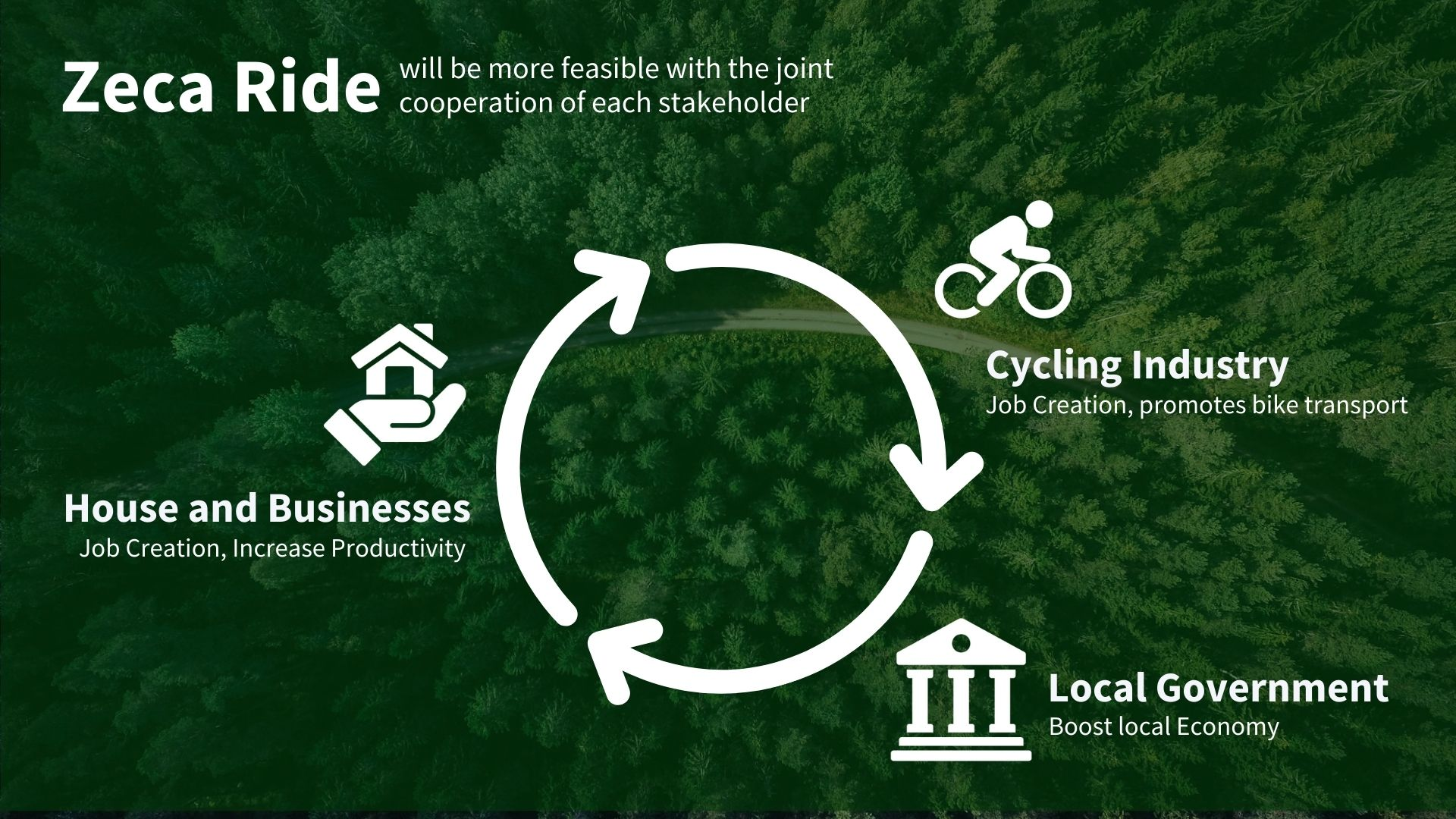

Slide 17
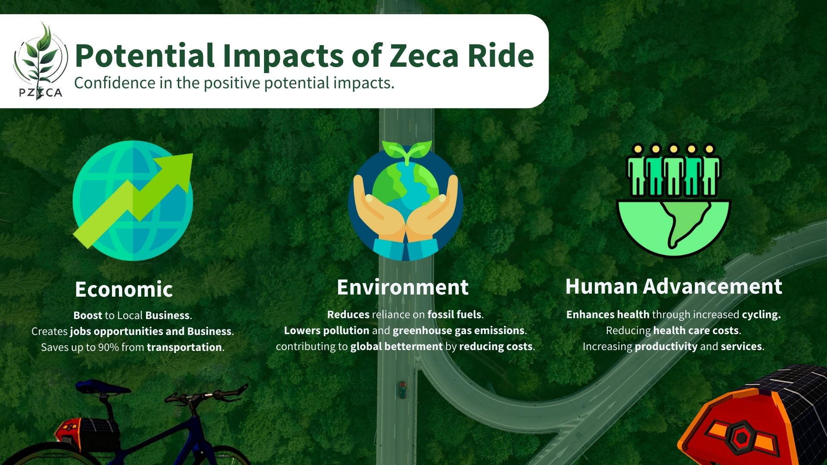

Slide 18
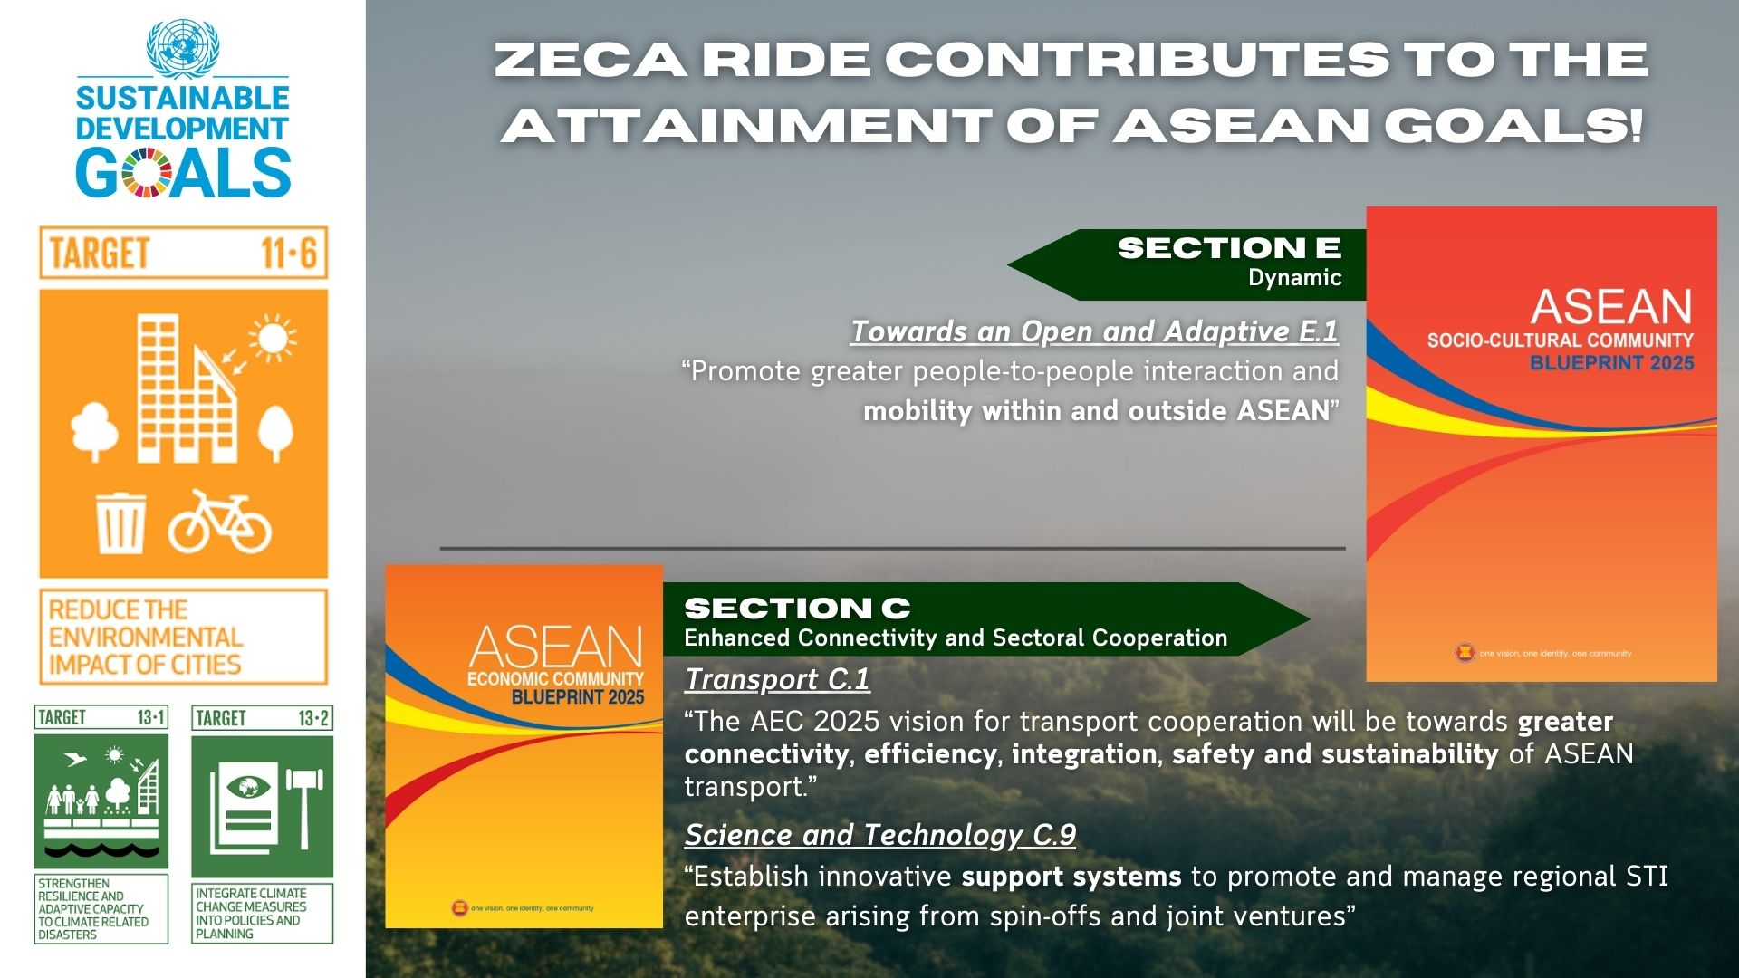

Slide 19
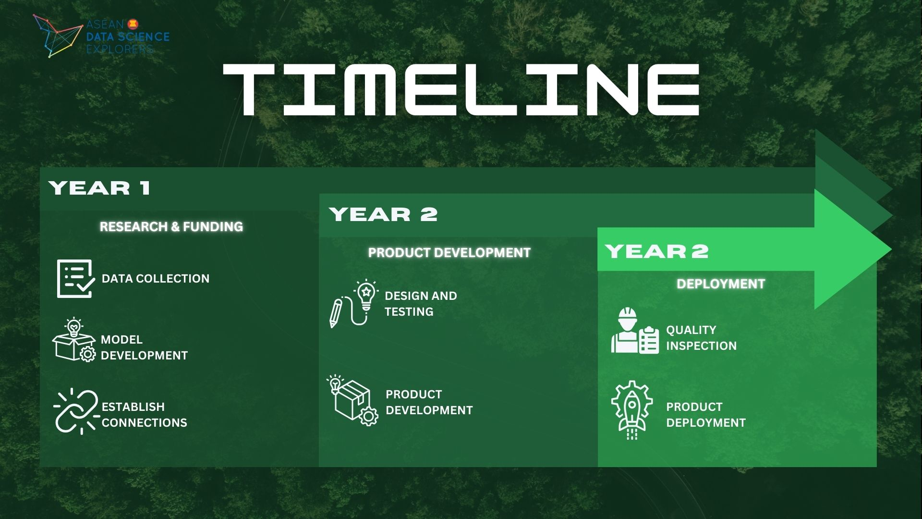

Slide 20


Slide 21


references
ASEAN. (2021). ASEAN State of Climate Change Report. https://asean.org/wp-content/uploads/2021/10/ASCCR-e-publication-Correction_8-June.pdf
Hannah Ritchie, Pablo Rosado and Max Roser (2020) - “Greenhouse gas emissions” Published online at OurWorldInData.org. Retrieved from: 'https://ourworldindata.org/greenhouse-gas-emissions' [Online Resource]
IEA (2022), Global CO2 emissions from transport by sub-sector in the Net Zero Scenario, 2000-2030, IEA, Paris https://www.iea.org/data-and-statistics/charts/global-co2-emissions-from-transport-by-sub-sector-in-the-net-zero-scenario-2000-2030, Licence: CC BY 4.0
EPA. (2022, June 30). Greenhouse Gas Emissions from a Typical Passenger Vehicle. US EPA; United States Environmental Protection Agency. https://www.epa.gov/greenvehicles/greenhouse-gas-emissions-typical-passenger-vehicle#:~:text=typical%20passenger%20vehicle%3F-
ASEAN REGIONAL STRATEGY ON SUSTAINABLE LAND TRANSPORT. (2019). https://asean.org/wp-content/uploads/2019/03/ASEAN-Regional-Strategy-for-Sustainable-Land-Transport-Final.pdf?fbclid=IwAR10Ka4A6C-5nxpQBbE6k_msXONkFfpQ2EUXAPE3EcAH7oc69j9ALeKHHC4
Feenstra et al. (2015), Penn World Table (2021) – with major processing by Our World in Data. “Annual working hours per worker” [dataset]. Feenstra et al. (2015), Penn World Table (2021), “Penn World Table” [original data].
Christian B et al. (2021), The Climate Change Mitigation Effects of Daily Travel in Cities. https://www.sciencedirect.com/science/article/pii/S1361920921000687

